Slide 1
ECO Vision
– GreenSpark Hackathon Idea

Slide 2
Agenda
ECOSync – An Overview
Theme / Problem being addressed
Business Value
Novelty
Technology being levarged
Prototype – an overview
Demo
2

Slide 3
EcoSync – An Overview
Theme 2:
A common pluggable framework to be able to pull the ESG information from different 3rd party technologies ( VMware, hyperscalers, etc..) into common data lake ( Bridge) and make it available for insights.
EcoSync:
A common Plug & Play framework that collects the ESG metrics
→ from multi-varied technological and business environment
→ to provide the ESG report, Predictive insights and implementable advice to enhance ESG & Sustainability.

Slide 4
Problem being addressed
In recent days, ESG considerations have become increasingly important for businesses. While IT service providers outshining to provide 360-degree visibility towards the IT resources to enrich the availability and performance, there is no enterprise level or industrial solution available today to offer a concreate guidance on ESG investments for the organizations.
EcoSync – Scope and capabilities:
A Plug & Play Framework that collects ESG metrics
Common Framework that accommodates diverse technological and industrial systems
Aggregates, correlates and analyzes quantitative and qualitative ESG metrics and transforms into Unified format
Metrics Library develops and contains customizable indicators
Delivers ESG reports in addition to the IT Observability dashboards
Provides guidance to ESG investments based on the selected indicator
Predictive insights and advise to enhance the ESG considerations

Slide 5



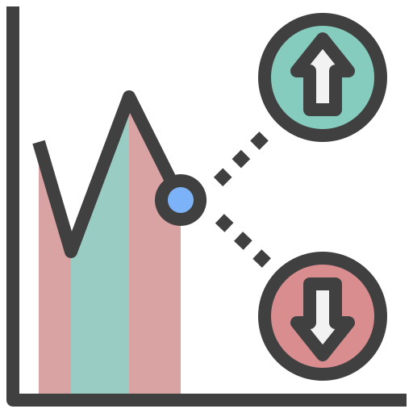


EcoSync – An Overview
Wide Range of Technologies
Various hosting Platforms
EcoSync Data Collection Framework
Cognitive Load Manager
Data Aggregation & Correlation
Analytic Engine
Various Industry Verticals
Insights & Predictions
Quantitative ESG Metrics
Choice of Enterprise application
Metric Library
ESG Indicators
Usage patterns / Utilization trends
Data Pipeline
AI/ML
Non-technical/Non-Financial Metrics
Insights with ESG report
Predictive Insights & advise
Policy Engine (Granular ESG Tagging)
Metric Advisor
Non-Tech Environmental metrics ( Power/Water Source / Conservation)
Qualitative ESG Metrics
Eco-Buddy
Social metrics (Diversity, Equity & inclusion)
Governance metrics (Ethics & Compliance)
IT Monitoring with EcoSync
Customer1 Banking Industry
Customer2 Retail Industry
Customer2 Energy Sector
…
Customer n
Xyz Industry
5

Slide 6
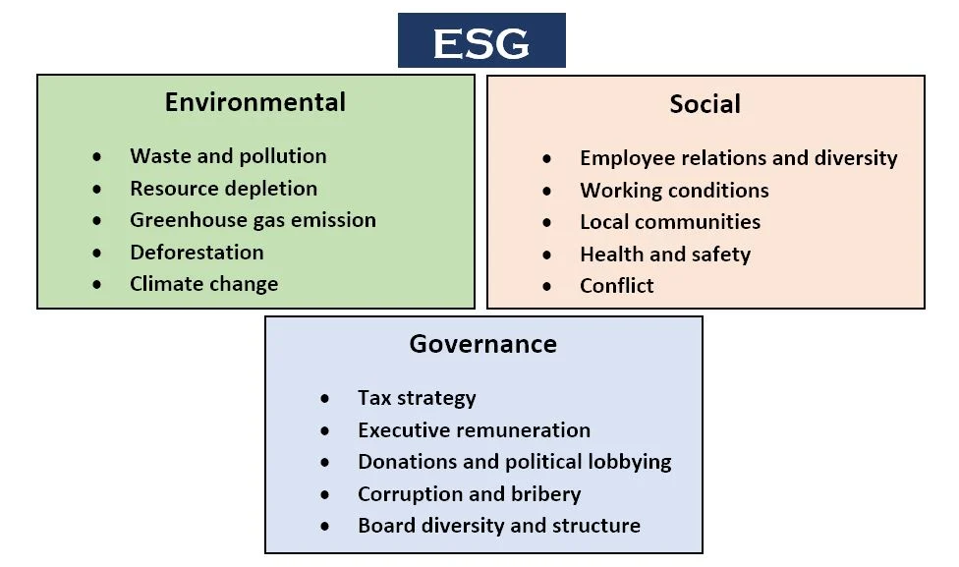
EcoSync:
A common Plug & Play framework that collects the ESG metrics
→ from multi-varied technological and business environment
→ to provide the ESG report, Predictive insights and implementable advice to enhance ESG & Sustainability.

Slide 7
Social Parameters
Ecovision collect the social and governance parameters from Hyperscale's and Score them them on social and governance Area.
Sustainability Advisory Offering
Hyperscalers
Microsoft
GCP
AWS
VMware
Redhat
Eco Vision
Eco Vision

Slide 8
Key differentiators
Sustaiblitlity advisory,
SA+ ESG --->AI/ ML-----> SA Reports + SG Insight based on custom indicators
Data collection (Sample Data)
. From documents or internet sources
Design SG Metric
collect the parameters from SG domain that can be uniformly measured for all the hyperscale's

Slide 9
EcoBuddy Cognitive Threshold Capacity
Working Conditions
Metrics
Employee Thriving:
Metric: Sustainability Engagement Score (SES)
Description: The Sustainability Engagement Score measures the level of employee engagement and participation in sustainability initiatives facilitated by EcoBuddy. It evaluates factors such as involvement in energy-saving challenges, participation in sustainability workshops or events, and contributions to the organization's environmental goals.
Energized:
Metric: EcoWellness Index (EWI)
Description: The EcoWellness Index assesses employees' overall well-being and vitality within the workplace environment influenced by EcoBuddy's initiatives. It considers factors such as physical health (e.g., energy levels, fatigue), mental well-being (e.g., stress levels, focus), and emotional resilience (e.g., positivity, motivation) resulting from participation in wellness challenges, mindfulness exercises, and energy-saving activities.
Meaningful Work:
Metric: Sustainability Impact Perception (SIP)
Description: The Sustainability Impact Perception metric evaluates employees' perceptions of the meaningfulness and significance of their work in contributing to environmental sustainability through EcoBuddy. It encompasses factors such as alignment of personal values with sustainability goals, sense of purpose derived from participation in eco-friendly initiatives, and perceived impact on the organization's sustainability mission. |Brain data can be exploited to make workers more efficient—and, proponents of the technology say, to make them happier. Source: https://spectrum.ieee.org/neurotech-workplace-innereye-emotiv

Slide 10
Focusing on
Data collection

Slide 11
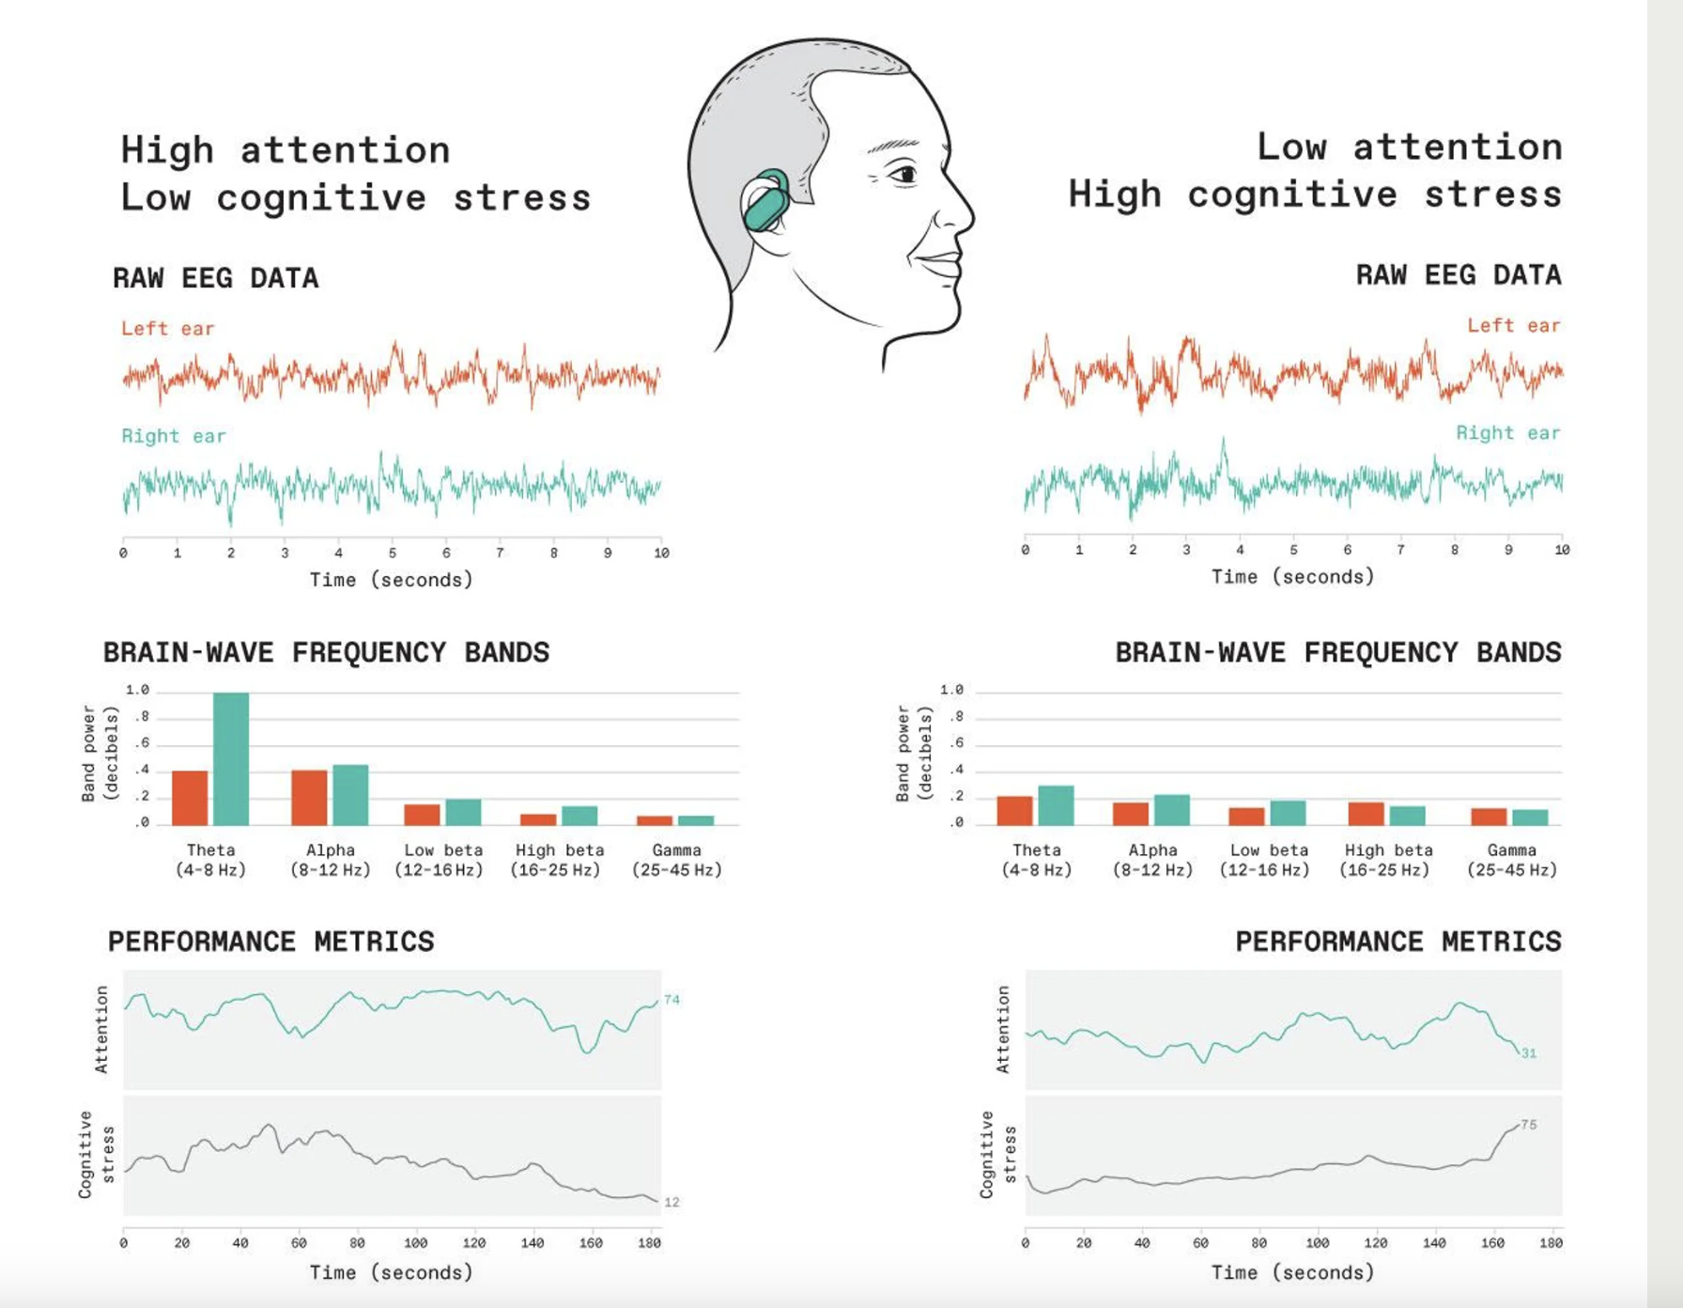
Source: https://spectrum.ieee.org/neurotech-workplace-innereye-emotiv

Slide 12
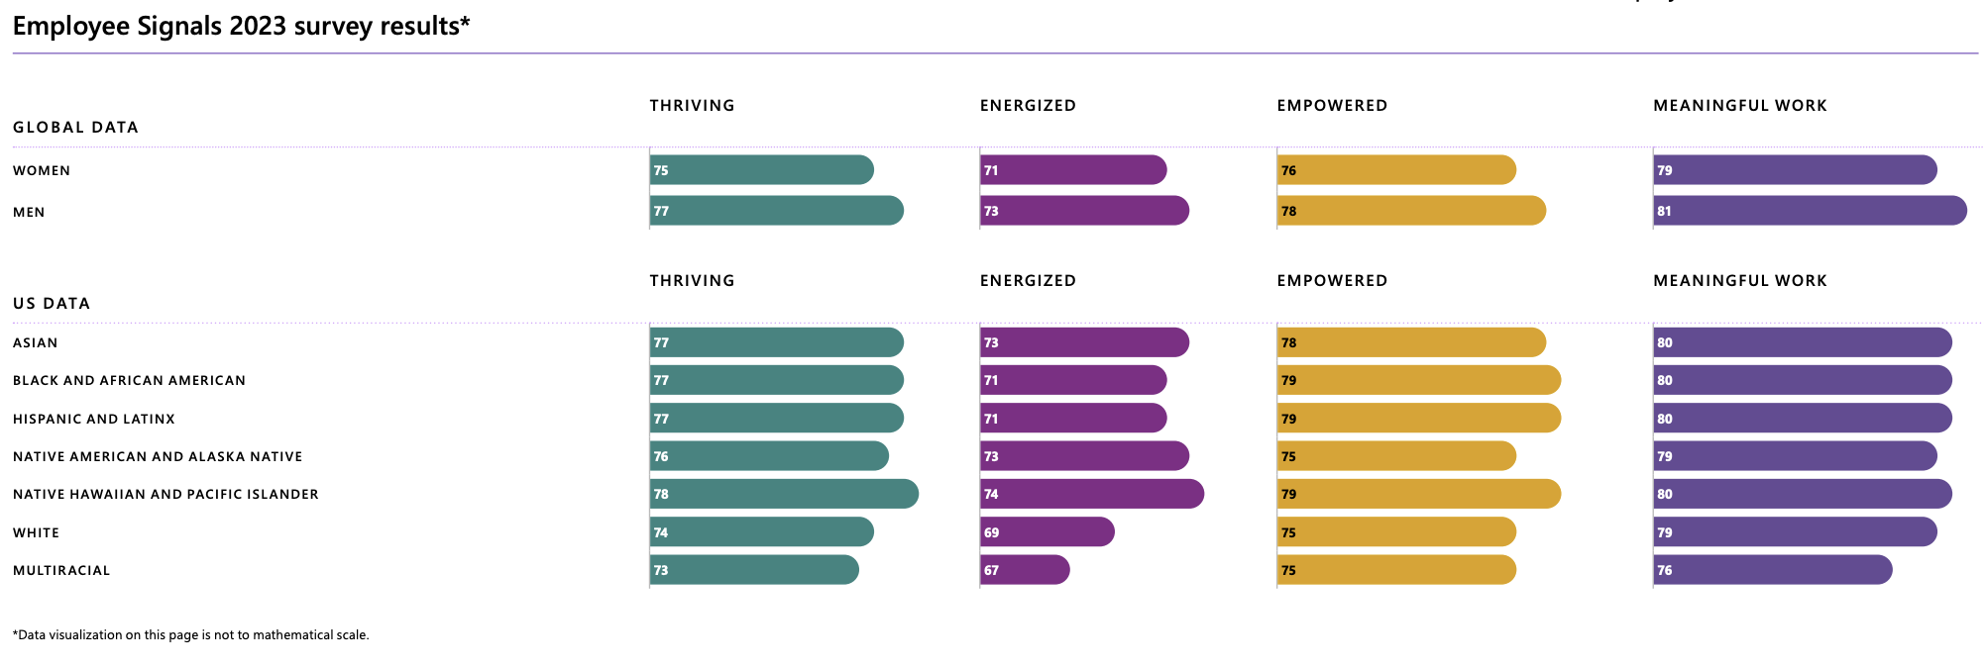
Microsoft Sustainability Report-2023
Reference link: https://www.microsoft.com/en-us/corporate-responsibility/reports-hub

Slide 13
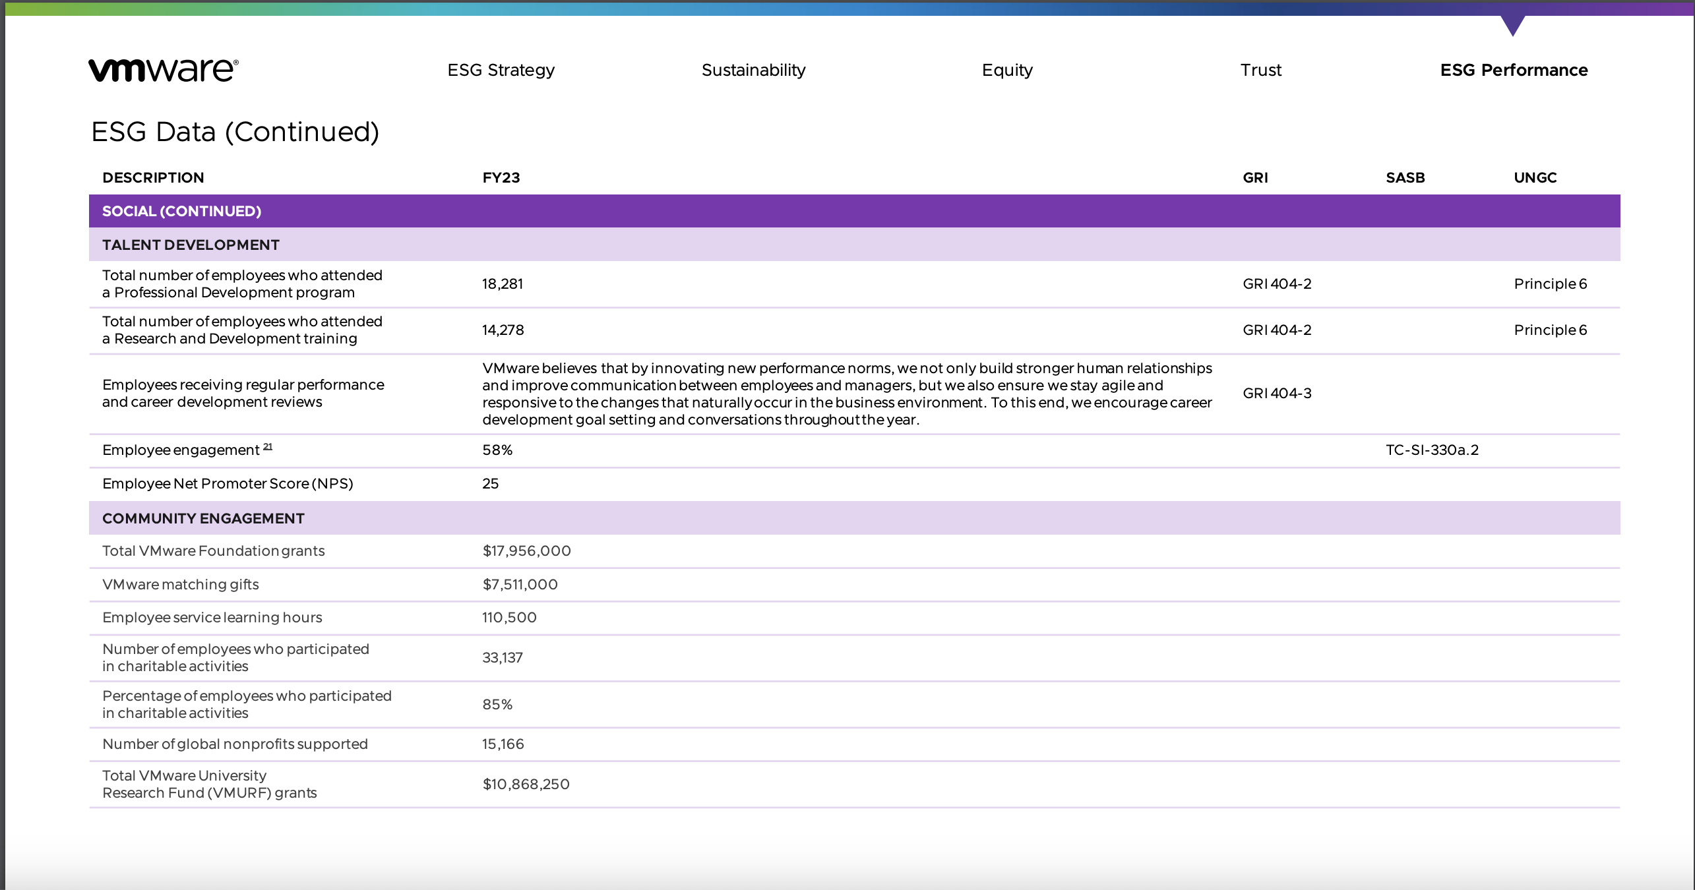
VMWARE ESG Report 2023
Employee Relations

Slide 14
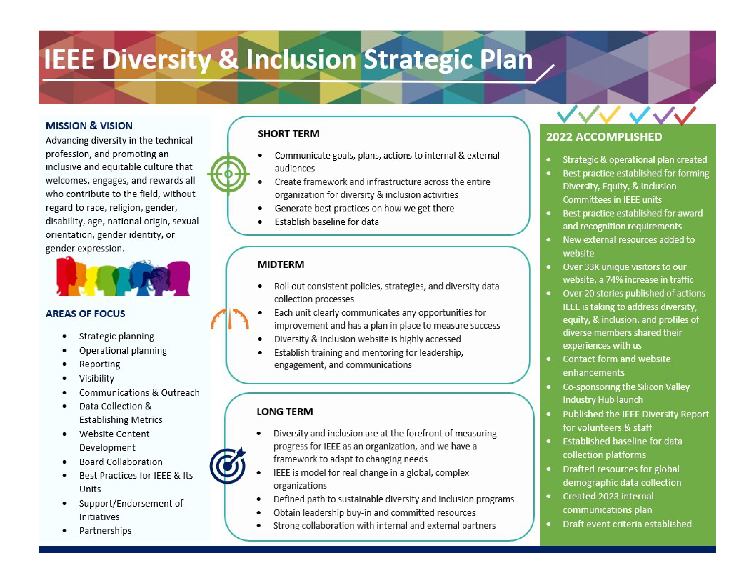
IEEE Strategic Plan –Diversity & Inclusion

Slide 15
USECASE
Employee Relations & Well being
Imagine Sarah, an employee at a large corporation, is responsible for managing energy usage in her department. She's often overwhelmed by the amount of data she needs to analyze and the decisions she needs to make to optimize energy efficiency while balancing productivity and comfort for her team.
With EcoBuddy in EcoSync, Sarah receives personalized recommendations and insights tailored to her department's energy usage patterns and goals. EcoBuddy analyzes real-time data from sensors installed throughout the office, including lighting, heating, and cooling systems, as well as employee occupancy levels.
Here's how EcoBuddy helps Sarah thrive:
Energized: EcoBuddy provides Sarah with real-time feedback on energy usage, helping her identify opportunities to reduce waste and conserve resources. This empowers her to take proactive steps to optimize energy efficiency, leading to cost savings and environmental benefits.
Empowered: Sarah feels empowered to make informed decisions about energy management, thanks to EcoBuddy's actionable insights and recommendations. She can adjust settings on heating and cooling systems, schedule lighting controls, and encourage energy-saving behaviors among her team.
Meaningful Work: By actively contributing to energy conservation efforts, Sarah finds her work more meaningful and fulfilling. She sees the positive impact of her actions on the environment and the company's bottom line, fostering a sense of purpose in her role.
Cognitive Capacity Threshold: EcoBuddy relieves Sarah's cognitive burden by automating data analysis and providing clear, concise recommendations. Instead of spending hours sifting through spreadsheets and reports, Sarah can focus her cognitive capacity on strategic decision-making and problem-solving.

Slide 16
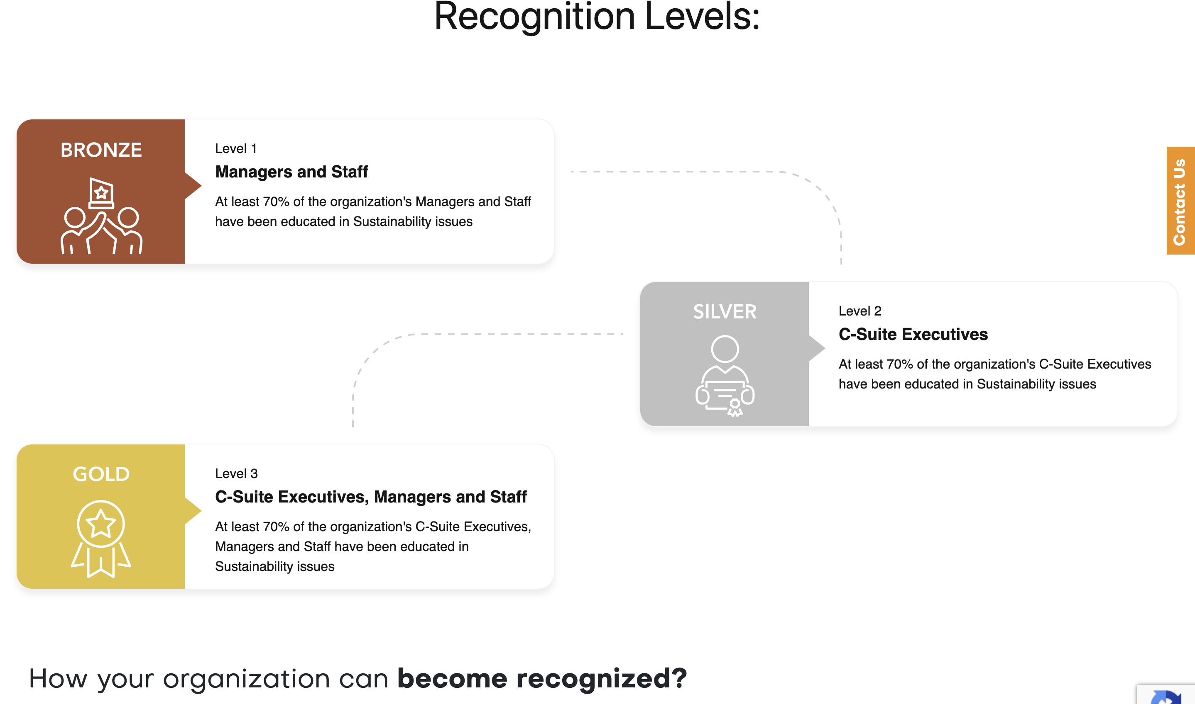
Source:https://sustainability-academy.org/recognized-sustainable-employer-invest-in-workforce/

Slide 17
Social Parameters
Key Differentiator
What data? SG
What Metrics? SG
We bult usecase?

Slide 18
Metrics

Slide 20
Thank you

Slide 21
EcoSync – An Overview
Wide Range of Technologies
Various hosting Platforms
EcoSync Data Collection Framework
Greenhouse Manager
Data Aggregation & Correlation
Analytic Engine
Various Industry Verticals
Insights & Predictions
Quantitative ESG Metrics
Choice of Enterprise application
Metric Library
ESG Indicators
Version 0.1
Usage patterns / Utilization trends
Data Pipeline
AI/ML
Non-technical/Non-Financial Metrics
Insights with ESG report
Predictive Insights & advise
Policy Engine (Granular ESG Tagging)
Metric Advisor
Non-Tech Environmental metrics ( Power/Water Source / Conservation)
Qualitative ESG Metrics
Social metrics (Diversity, Equity & inclusion)
Governance metrics (Ethics & Compliance)
IT Monitoring with EcoSync
Customer1 Banking Industry
Customer2 Retail Industry
Customer2 Energy Sector
…
Customer n
Xyz Industry
21

Slide 22
EcoSync – Ux
ABC Co - Intranet Portal
Digital Wallet
Digital Wallet
Data Feed
+ Env Metrics
Mode of commute
- Commute mode/Details
Average Distance
+ Social Metrics
Average time during peak hrs
- Voluntary Activities
- Self Discipline/ Responsibilities
Average time during off peak hrs
+ Governance Metrics
Your travel time
Access Control
22

Slide 23
EcoSync – Ux
Eco-Sync Data collection Framework
Digital Wallet Data Feed
Digital Wallet Consolidated Data Repo
Parking Allocation app
Car Pooling reg app
Survey details on Employee commute pattern
23

